Slide 1



Introduction to Stream Processing
with Kafka Streams
@binitakaushik18
Binita Kaushik

Slide 2
Agenda
Stream Processing
Streams vs Batch
Windowing
Kafka and Kafka Streams in brief
Kafka Streams concepts
Demo on Kafka streams
Closing notes

Slide 3
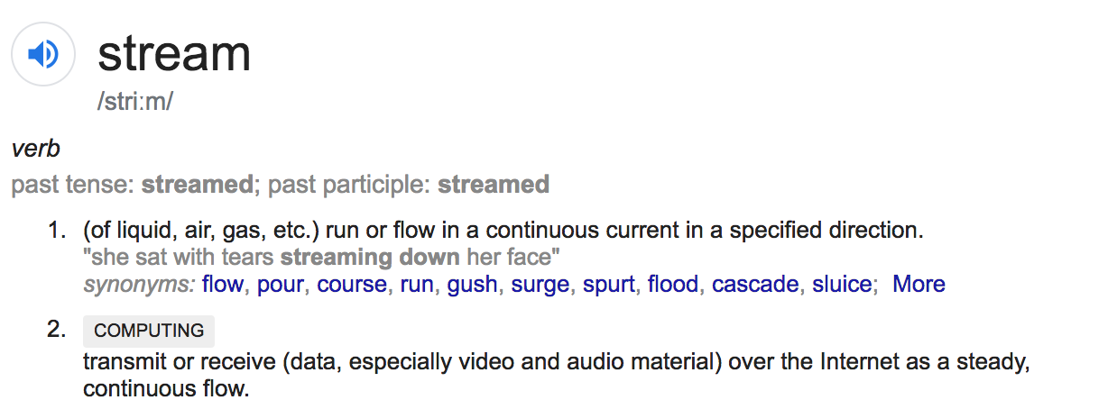
What is Stream Processing

Slide 4
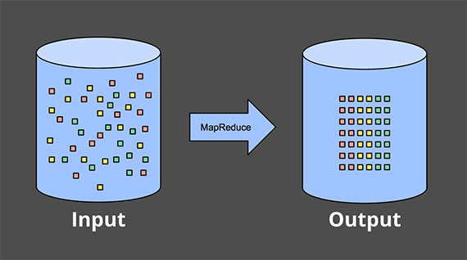
What makes Stream Processing complex
Batch(Bounded data)
Image: Tyler Akidau

Slide 5
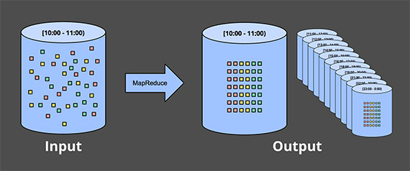
Streams (Unbounded data)
Image: Tyler Akidau

Slide 6
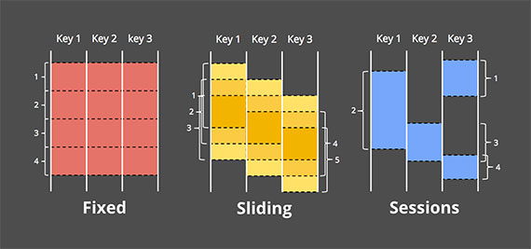
Windowing in Streams
taking a data source and chopping it up along temporal boundaries into finite chunks for processing
Image: Tyler Akidau

Slide 7
Windowing in Streams
taking a data source and chopping it up along temporal boundaries into finite chunks for processing
Image: Tyler Akidau

Slide 8
Windowing in Streams
taking a data source and chopping it up along temporal boundaries into finite chunks for processing
Image: Tyler Akidau

Slide 9
Windowing in Streams
taking a data source and chopping it up along temporal boundaries into finite chunks for processing
Image: Tyler Akidau

Slide 10

Does it solve your problem?
Quicker feedback loop
Real time trends
Identify security issues
Identify patterns over data set
Predictive analysis
Economic forecasting
VS

Slide 11
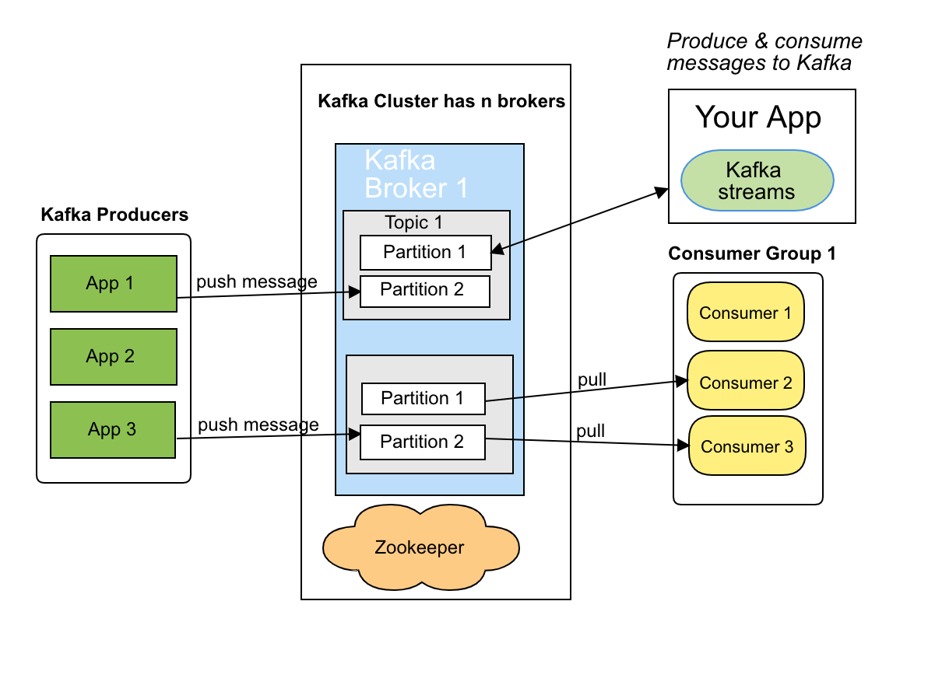
Kafka and Kafka Streams

Slide 12
Kafka Streams Concepts in brief
Streams DSL
KStreams & KTable
Topology
Stateful and stateless stream processing

Slide 13
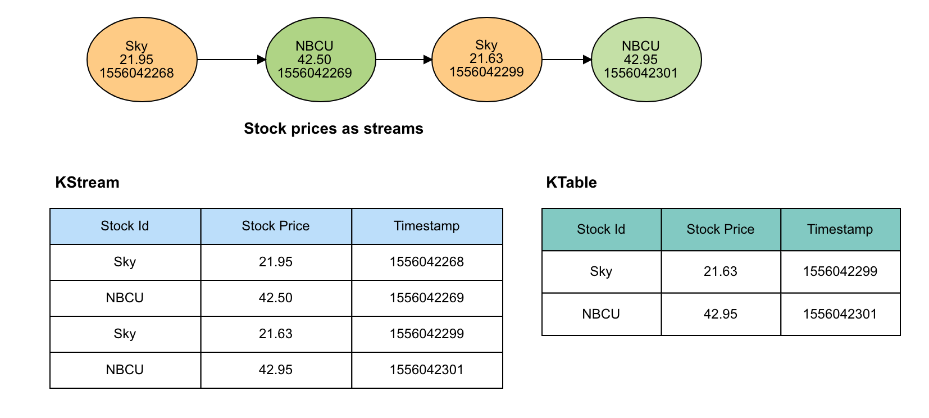
KStream (Insert) vs KTable (Upsert)

Slide 14
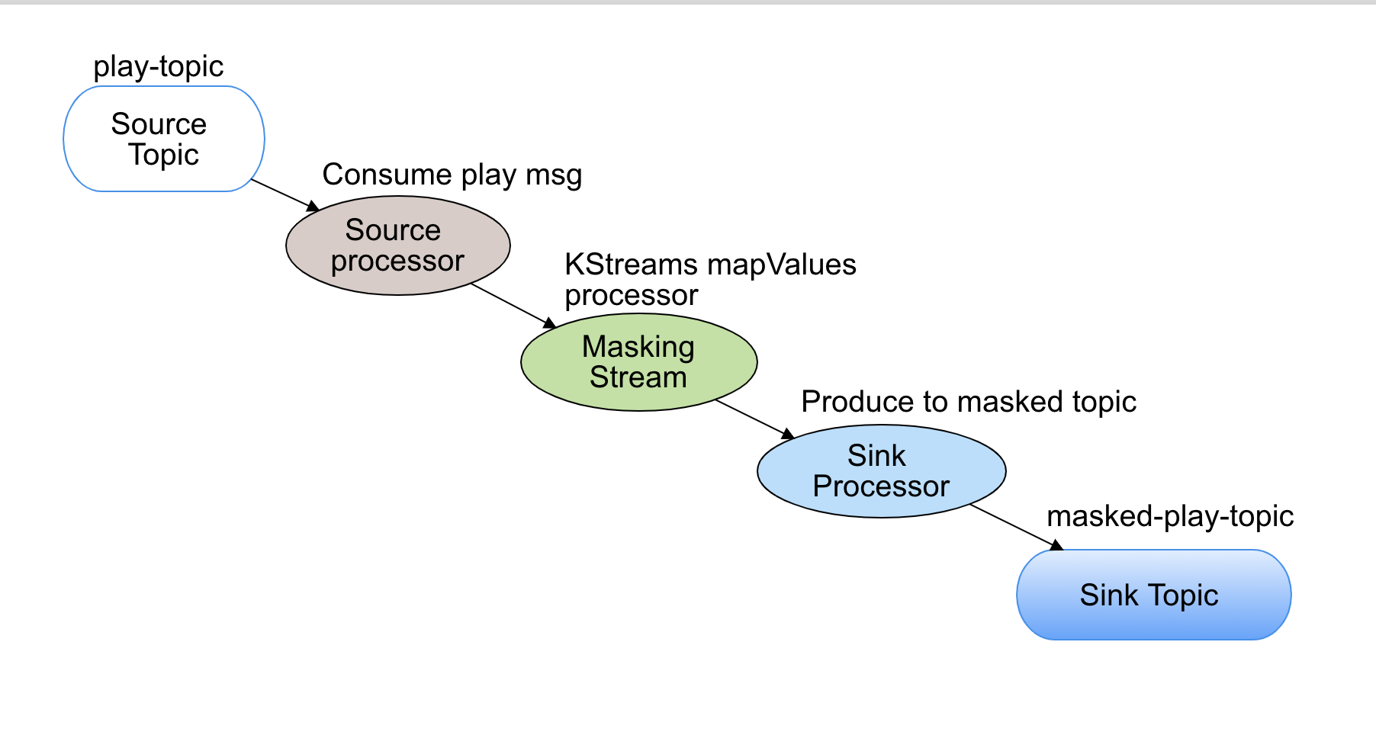
Demo masking PII Streams Topology

Slide 15
Demo time
Start kafka-streams-demo file

Slide 16
Finish Demo

Slide 17
Stateful & Stateless stream processing
Joining streams
Lightyear can process 400 million messages in under 4 hours.
Size your instances appropriately

Slide 18
References
https://www.oreilly.com/ideas/the-world-beyond-batch-streaming-101
https://docs.confluent.io/current/streams/index.html
https://www.manning.com/books/kafka-streams-in-action
https://www.oreilly.com/ideas/why-local-state-is-a-fundamental-primitive-in-stream-processing

Slide 19

Questions
May all your streams come true

